Slide 1
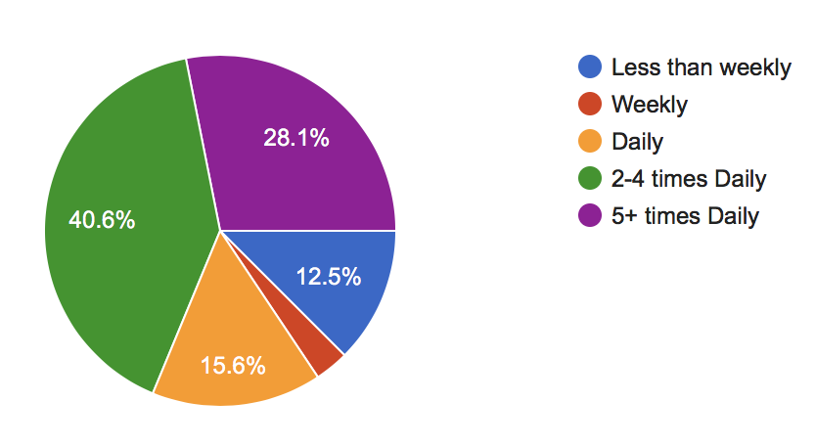
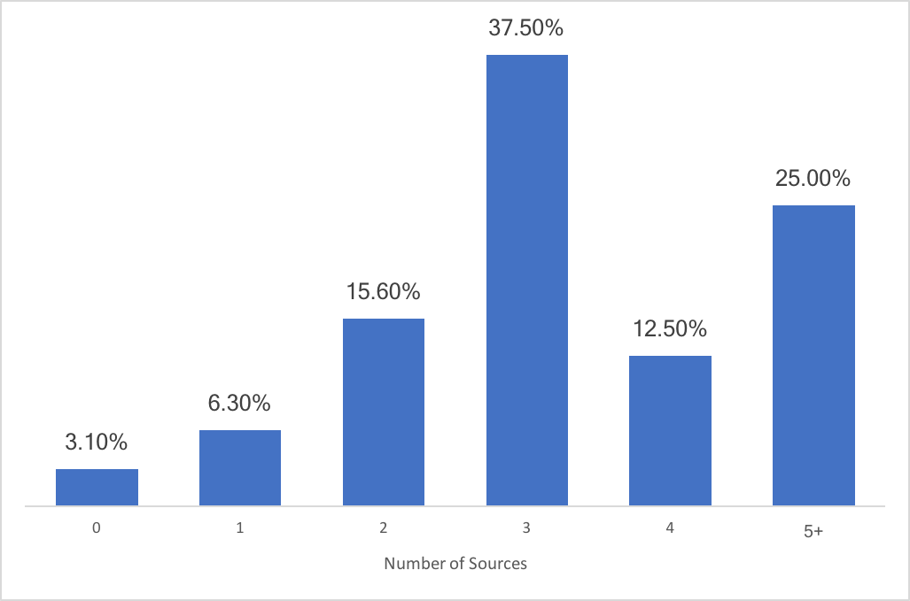
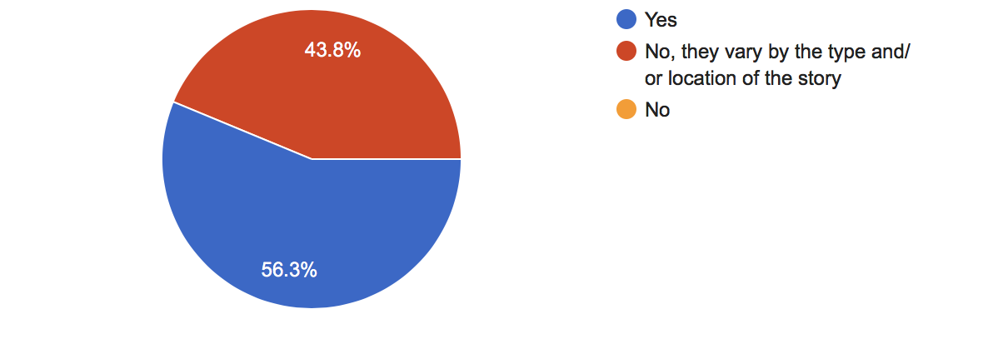
How many sources do you normally read for a piece of news?
How often do you read the news?
Do you use the same sources every time?

Slide 2
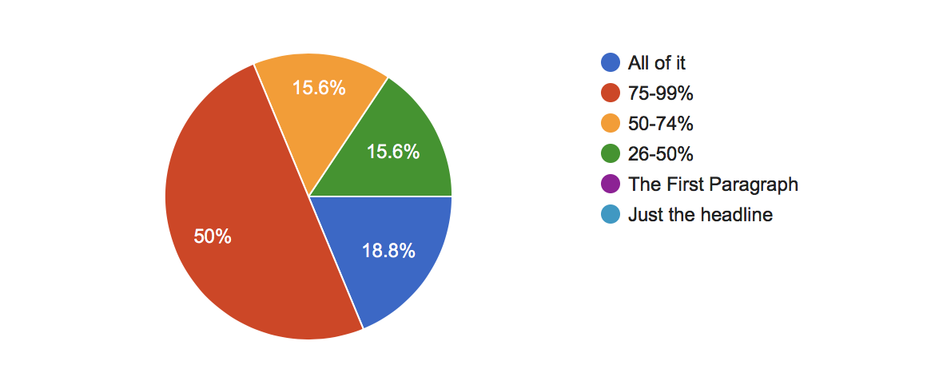
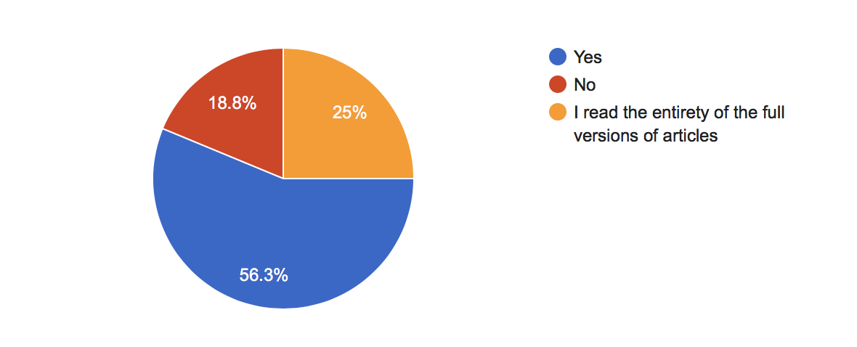
How much of an article do you normally read?
If an article was presented as a shorter summary, would you read more/all of it?

Slide 3
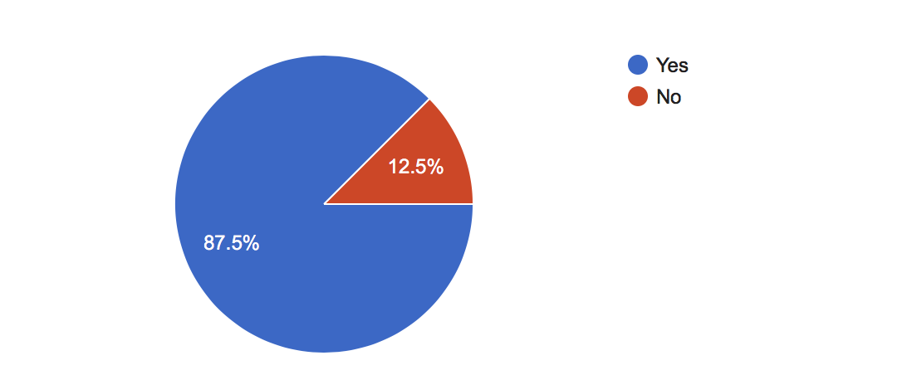
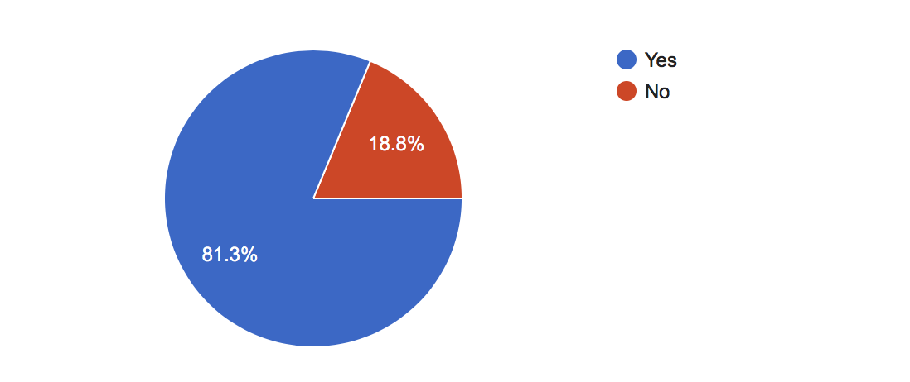
Would you read a summary of different articles on the same topic combined?
Would you use a News Aggregator that summarised articles?

Slide 4
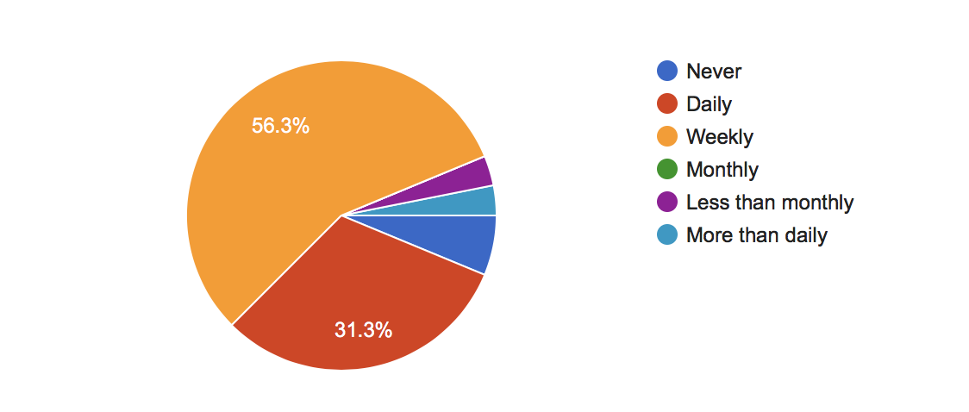
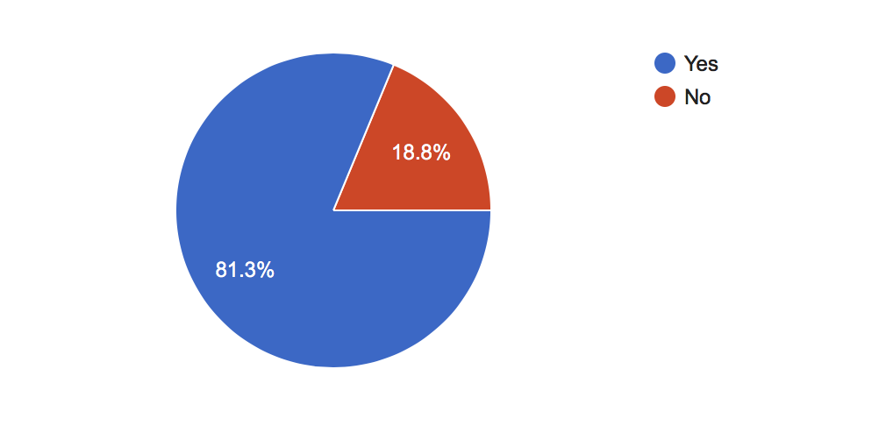
How often do you search for news on a specific topic?
Should the news aggregator have the ability to search for a specific topic?

Slide 5
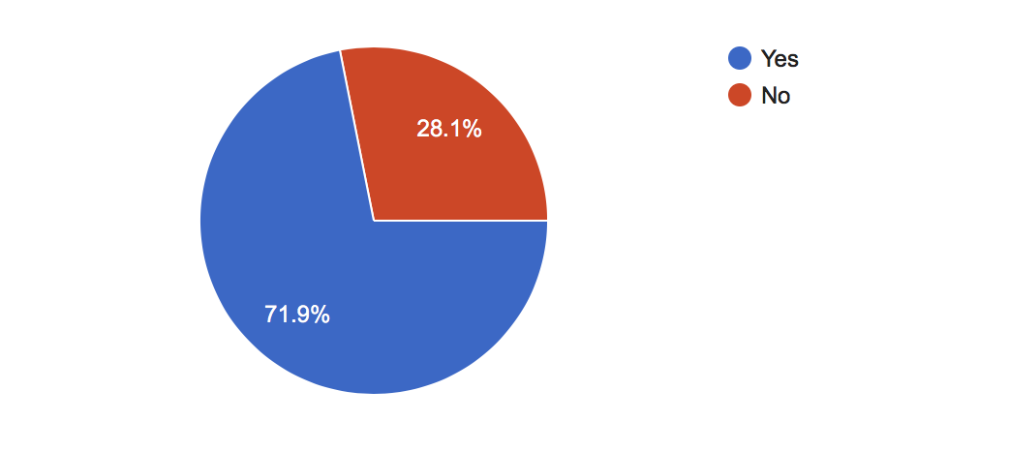
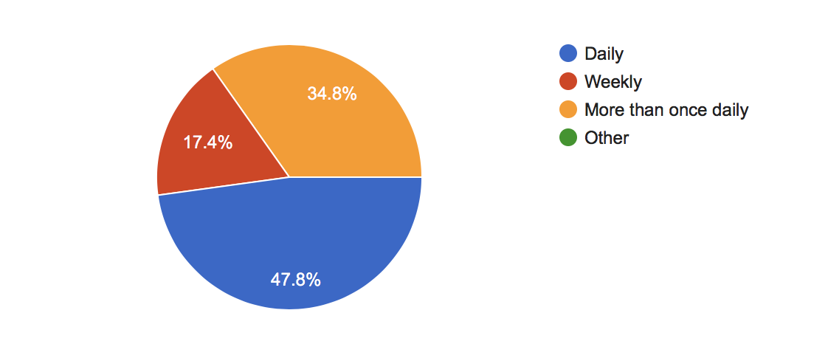
Do you like services such as news digests that prepare lists of articles each day that apply to a topic you may be interested in?
How often should these news digests be updated?

